Slide 1
How are people with disabilities in Norway satisfied with their service provision
by
Stein Wilmann
NHF Oslofjord Vest

Slide 2
About Norges Handikapforbund
Norges Handikapforbund means Norwegian Association of Disability
Our mission statement:
Norges Handikapforbund is an independent interest group working for full equality and participation in society for people with disabilities. The main target is the physically disabled.

Slide 3
About Norges Handikapforbund
Only organization in Norway that serves disabled people regardless of diagnosis
Our goal is a society without discrimination, where all people have the opportunity to participate equally in all areas.

Slide 4
About Norges Handikapforbund
300 local groups
9 regions
11 collectively affiliated diagnostic associations
1 youth organization
A total of approximately 15,000 members

Slide 5
Arrangements and rights
Norwegian Discrimination and Accessibility Act
UN Convention on the Rights of Persons with Disabilities (CRPD)
The Government's Action Plan for Universal Design
Norway should be universally designed by the end of 2025

Slide 6
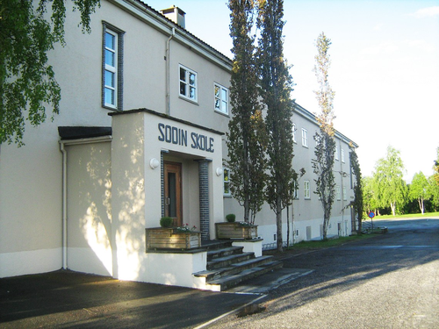
Buildings
Requirements for universal design of new buildings are implemented in the Legislation.
No deadline for existing buildings to be universally designed.
80% of the existing primary schools have significant deficiencies in accessibility

Slide 7
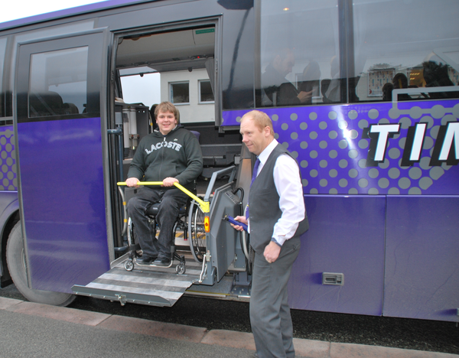
Transport
Public transport and gateways still have major shortcomings in accessibility for people with reduced mobility
European standards for universal design in the transport area is also valid for Norway

Slide 8
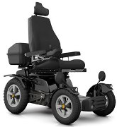
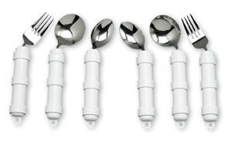
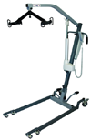
Technical aids
National Insurance Act
Ensures equal right to aids in all areas of life
The right is beeing threatened
The smallest and cheapest aids have been taken out of the system

Slide 9
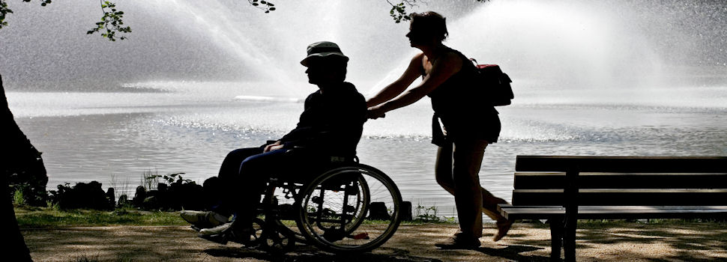
User-driven Personal Assistant (UPA)
Many disabled are excluded from many arenas in the society because they receive insufficient assistance
We want UPA to be an individual right for all who need this
The legislation is on its way
Elements in the coming law are inadequate

Slide 10
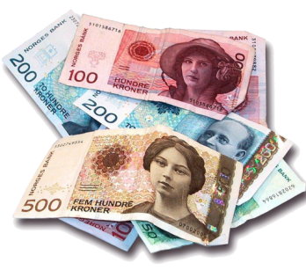
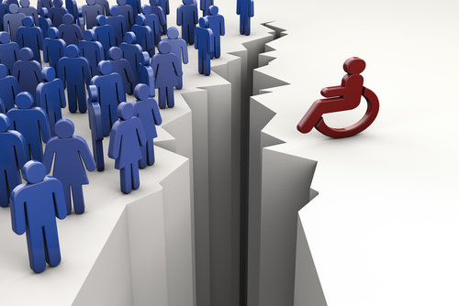
The economical field
Social security and pensions
Compensaton for the extra expenses caused by illness and/or disability
People with disabilities have poorer economy than the general population
The gap is increasing

Slide 11
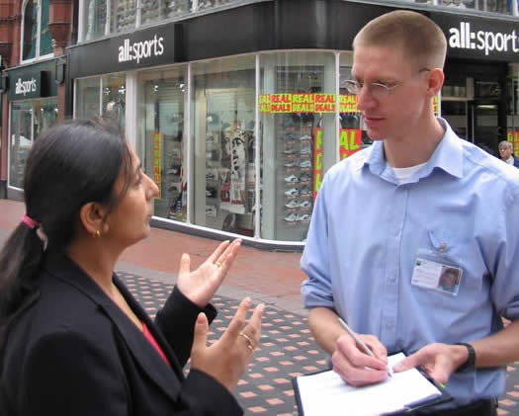
General attitude
The people on the street think equal opportunities for people with disabilities is fair
The good attitudes might only be skin deep when it comes to showdown
We have an attitude problem, even though it does not seem that way on the surface.

Slide 12
The NAV reform
Before 2006: Three separate public agencies that each handled their share of the welfare system
A government agency for all of the benefits and pensions, including technical aids
A government agency for everything to do with businesses and unemployment
A municipal agency ensure that everyone has a living minimum (The social services)

Slide 13
The NAV reform
2006: These three agencies merged into one system called NAV.
The social services is still a municipal responsibility
16,000 public servants were affected by the reform
The entire Norwegian population were also affected as users of the services
NAV manages one-third of Norway's National budget.

Slide 14
The NAV reform
NAV’s main goals:
More people working or in other form of activity, fewer people receiving benefits
Easier for the users and better services tailored to their needs
A comprehensive and effective employment and welfare management
This process has not been painless, neither for the staff nor for the users

Slide 15
Living conditions and social inclusion
Report: “Living conditions and social inclusion of people with physical disabilities”
People with physical disabilities aged 30-50 are much worse off in the labor market than the rest of the population
36% of people with disabilities are employed, 87% in the general population

Slide 16
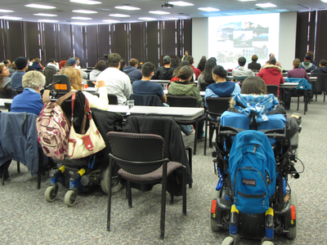
Living conditions and social inclusion
64% in this group had only primary school, 17% in the rest of the population
14% achieved higher education like university or college, 41% in the rest of the population
Lack of education is one of the main reasons for low labor force participation

Slide 17
Living conditions and social inclusion
The parents' social background and the participation in social activities after school has a greater impact on children with disabilities than the rest of the children
Segregated educational programmes
Is extensive used in Norway
Has many negative consequences
Used by municipalities to limit their spendings
Parents let themselves be persuaded instead of taking the fight to get their local school up to an acceptable standard

Slide 18
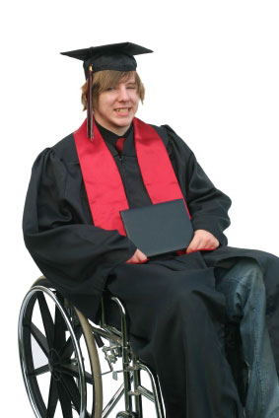
Living conditions and social inclusion
The youngsters should have the opportunity for to study further after primary school
To make that possible, the physical conditions in these schools and universities has to be facilitated
Good transportation is necessary to get to the schools and universities

Slide 19
“Everything is connected to everything else!” Gro Harlem Brundtland

