Slide 1
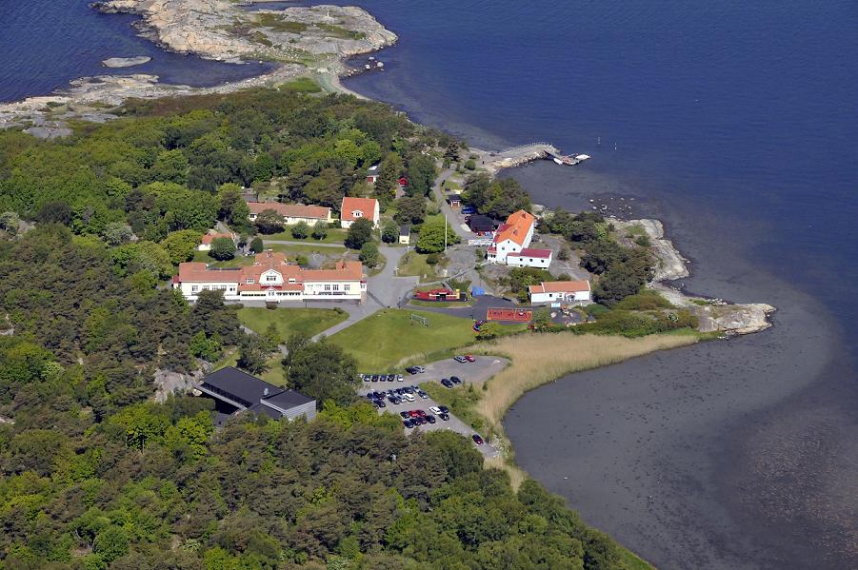
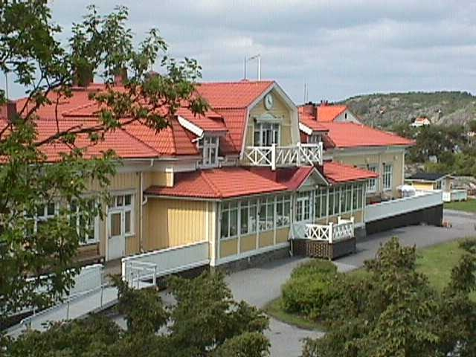
Ågrenska – a centre for children, teenagers and adults with disabilities, their families and professionals

Slide 2
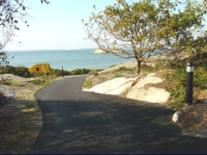
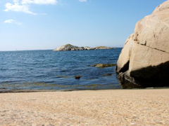
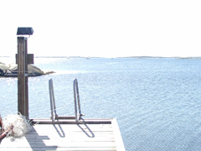
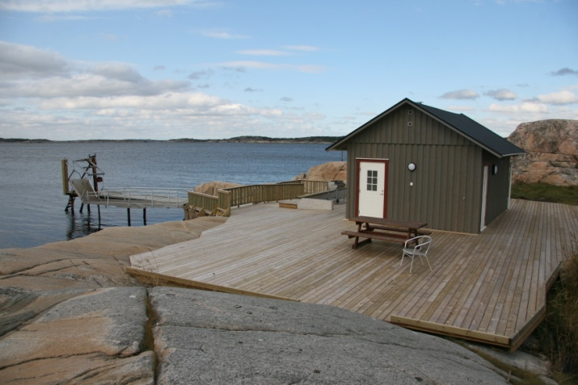
Ågrenska

Slide 3
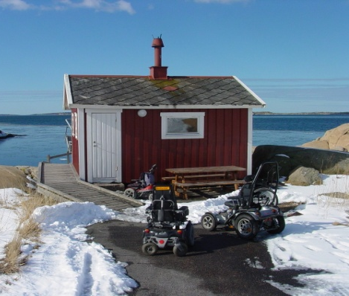
Ågrenska
All our programs have been planned and are carried out in cooperation with
representatives from authorities
parental organisations
/organisations for people with disabilities

Slide 4
Our programs – holistic perspective
Family program – focus on rare diseases
Adult program – focus on rare diseases
Respite care including summer camps
- all kinds of disabilities
Staff with disabilities
– day centre, adapted work
Personal assistance
ADHD consultant
Courses for professionals
Conferences
Projects/development

Slide 5
Why staff with disabilities?
Ågrenska´s vision includes to contribute to
creating possibilities for an optimal life for
people with disabilities - a holistic approach
Society level – influence through information/knowledge dissemination
Individual level – a good job is part of
a good life

Slide 6
Ågrenska – inclusion at work
Formal framework
Practical work

Slide 7
Formal framework
Daily occupation/day centre
responsibility of city council
Act on Support and Service &
Social Insurance Act

Slide 8
Formal framework
Ordinary employment
– part of salary financed by state
Public Employment Service

Slide 9
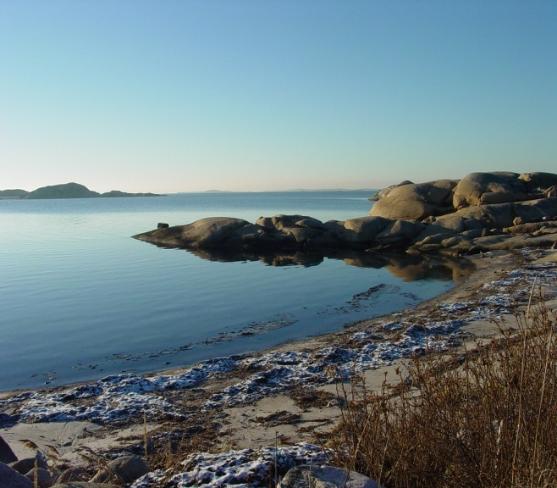


Extensive legislation
1994 Act on Support and Services
for Certain Persons with Functional Impairments
Ten rights
day centre/daily occupation – one of these rights

Slide 10
Act on Support and Services
Comprises support to people with severe disabilities
Oct 2012: almost 69 000 people
~ 0,75 %
32 000 – daily occupation/day centre
(10 000 – respite care)
City councils/municipalities
are responsilble for these services

Slide 11
Formal framework
Attend daily occupation – not employed,
state ”pension”
Within the public insurance system

Slide 12
Can be arranged in different ways
Arranged by the municipalities themselves
The municipalities buy from other providers – Ågrenska one of those providers
Criteria to meet - Approval from authorities
to be permitted to run
Public procurements

Slide 13
Day centre
Three people attend this service at Ågrenska
Although they are not formally employed
they and we regard it as their job
In everyday working life they are part of the
Ågrenska staff

Slide 14
Ordinary employment - Wage subsidy
Ordinary employment –
the employer pays salary, taxes, insurance fees, social fees etc.
The employer gets a state wage subsidy from the Public Employment Service

Slide 15
Ordinary employment - Wage subsidy
The level of the subsidy depends on
the salary costs and
the working capacity/ability of the person
The employer can also get a montly ”supervisor subsidy”,
almost always needed to some extent

Slide 16
Ordinary employment - Wage subsidy
Renegotiated every four years –
but regarded as permanent
The level of the subsidy can be changed
according to the development of the person

Slide 17
How to achieve inclusion?
Basic values in the organisation
Respect everybody´s equal value
Everybody has the right to participation
in society, a good life
Focus on possibilities - Everybody can contribute
We can make a difference

Slide 18
To achieve inclusion - Ågrenska
Extra ordinarily advantageous situation:
Met people with disabilities for 25 years in our everyday work
Target groups/guests are people with all kinds of disabilities
Having work mates with disabilities
comes natural for us

Slide 19
To achieve inclusion
Create possibilities for people with disabilities to get a job,
is possible in many areas
Many employers´ contribution is important

Slide 20
Ågrenska´s staff with disabilities
Ten people with disabilities work daily at Ågrenska
65 - 90% wage subsidy
One fulltime employed boss/supervisor
(~ 25% boss ordinarily)

Slide 21
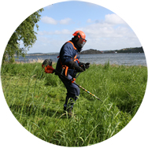
Ågrenska´s staff with disabilities
Target groups of today are people with:
Intellectual disabilities, 5
Neuropsychiatric, 4
Motor, 1

Slide 22
Ågrenska´s staff with disabilities
All tasks are adapted to the individual´s possibilities and needs,
creating possibilities to succeed is essential
Meaningful and age relevant tasks,
neccessary and important
Everyone participates in our social context, according to their own wishes
e.g. is invited and urged to take part in events for the staff, like meetings, study visits, trips, parties, after work

Slide 23
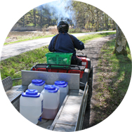
Ågrenska´s staff with disabilities
Tasks within the Ågrenska service and support sector, e.g kitchen, cleaning, gardening, care taking, telephone switchboard, mail order service

Slide 24
Tasks – telephone switchboard
answering all incoming calls,
switching to the right person,
distributing incoming mail
into everybody´s post box,
handling franking machine
document destruction

Slide 25
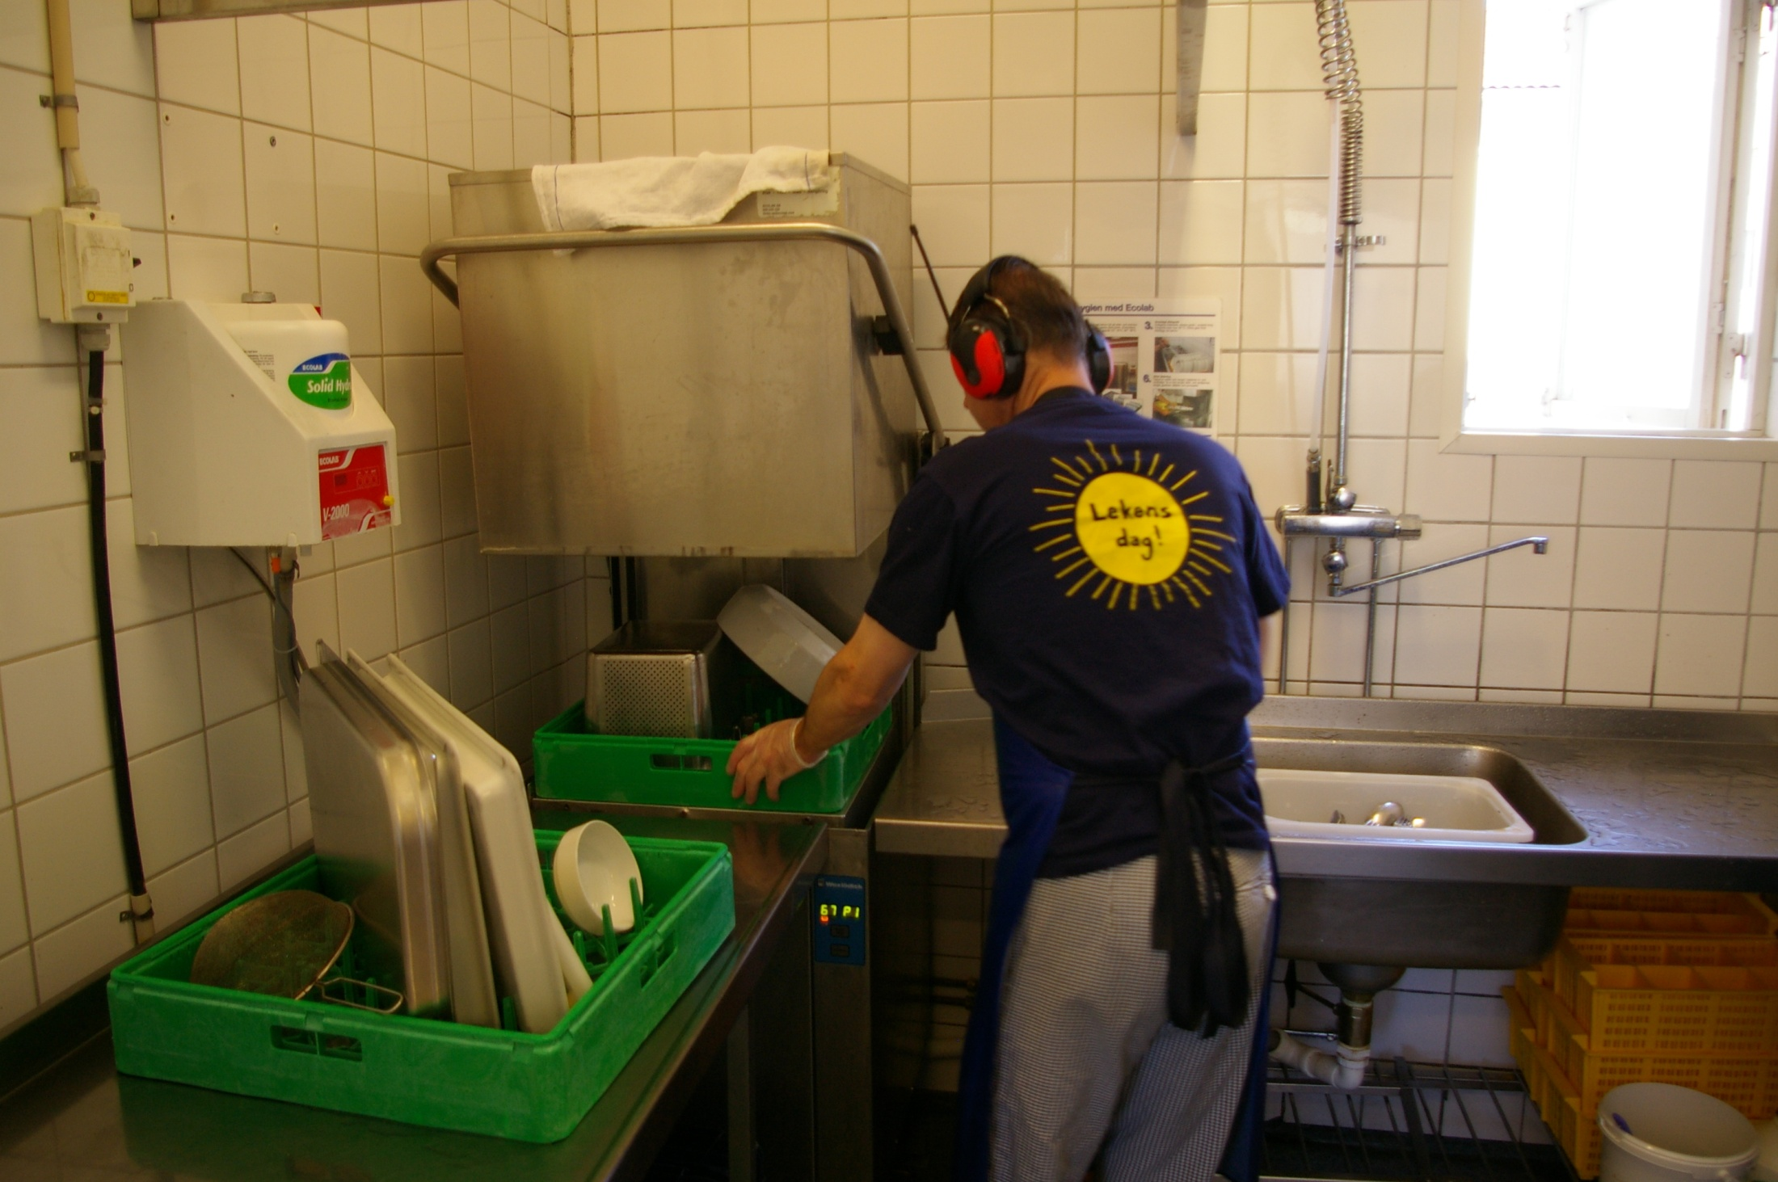
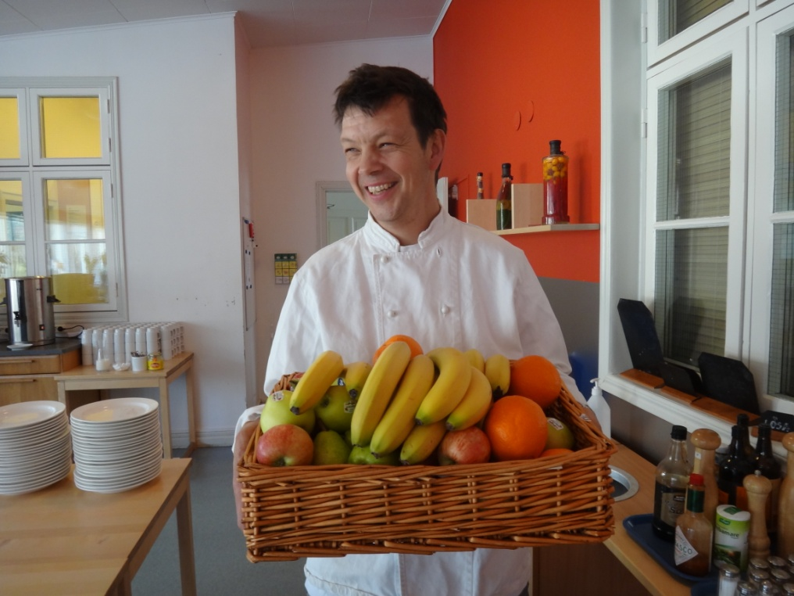
Tasks - kitchen
organising and carrying out dishwashing,
putting into cupboards, cleaning tables,
making sallad, coffee

Slide 26
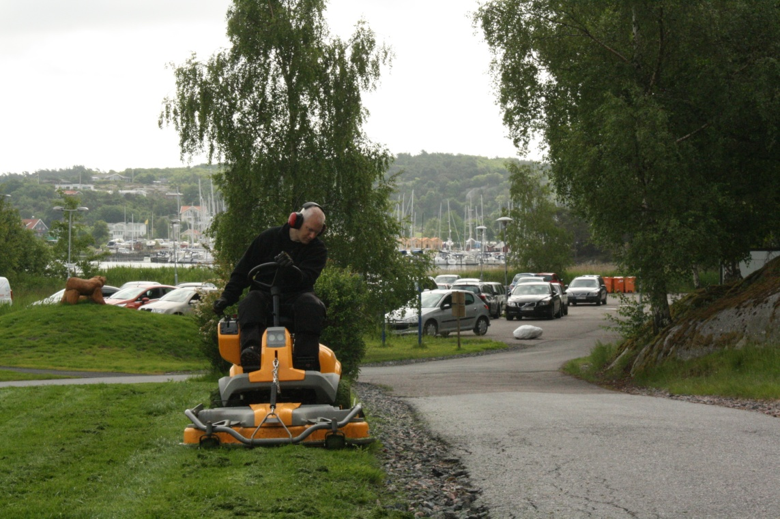
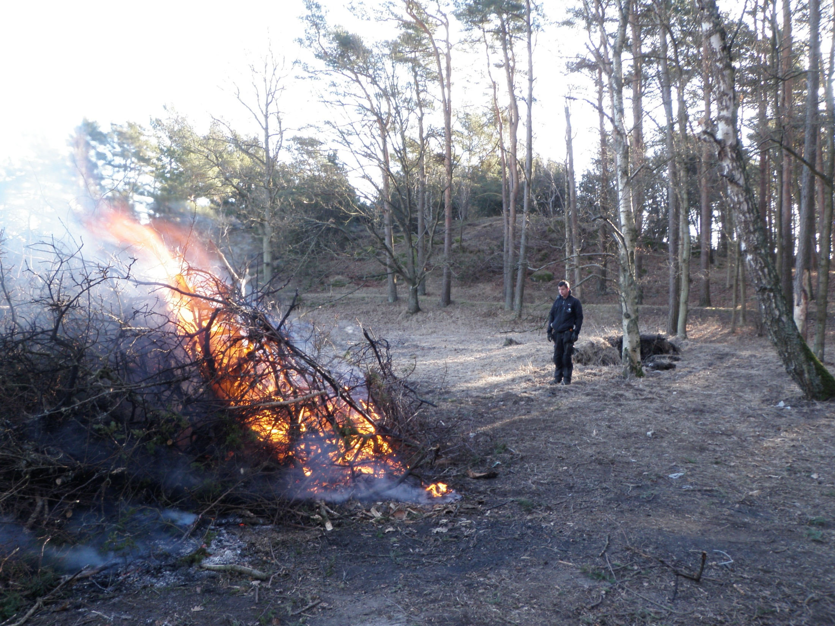
Tasks - gardening
lawn mowing, cutting bushes, planting,
burning lumber, branches, leaves

Slide 27
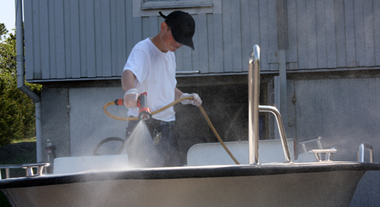
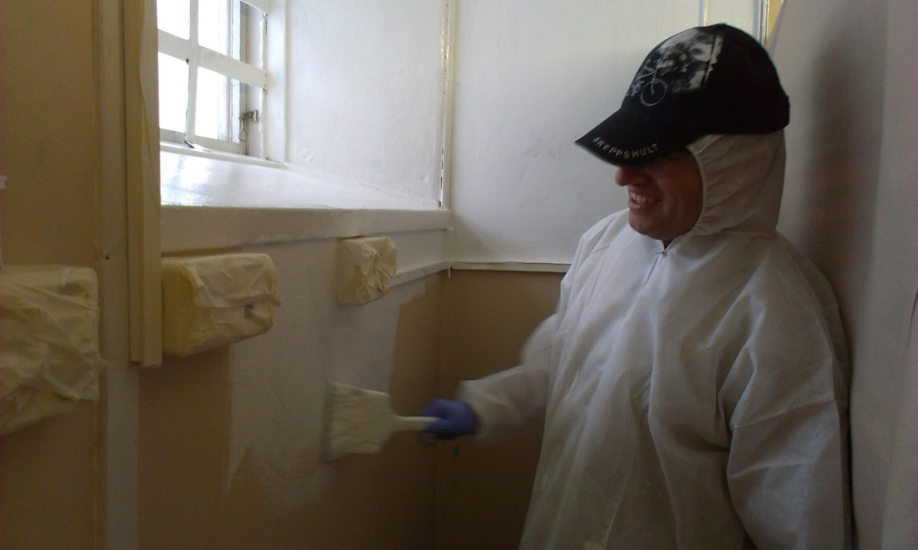
Tasks – caretaking
painting, car and boat washing
arrange furniture for different occasions
outdoor arrangements/constructions for events

Slide 28
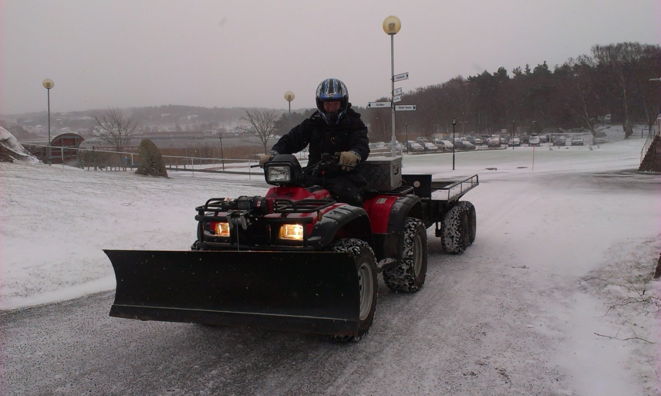
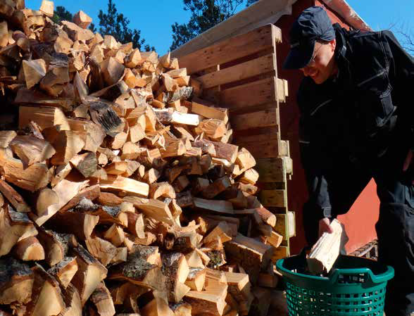
Tasks – caretaking
shovelling the snow away chopping firewood

Slide 29
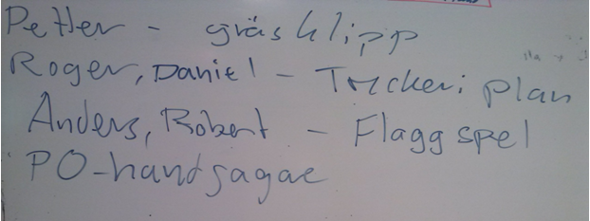
Adaptions for people with intellectual and neuropsychiatric disabilities
Structured days – routines:
short morning meeting – info about the tasks,
individually adapted written instructions
at the workingplace or a small pocket paper slip

Slide 30
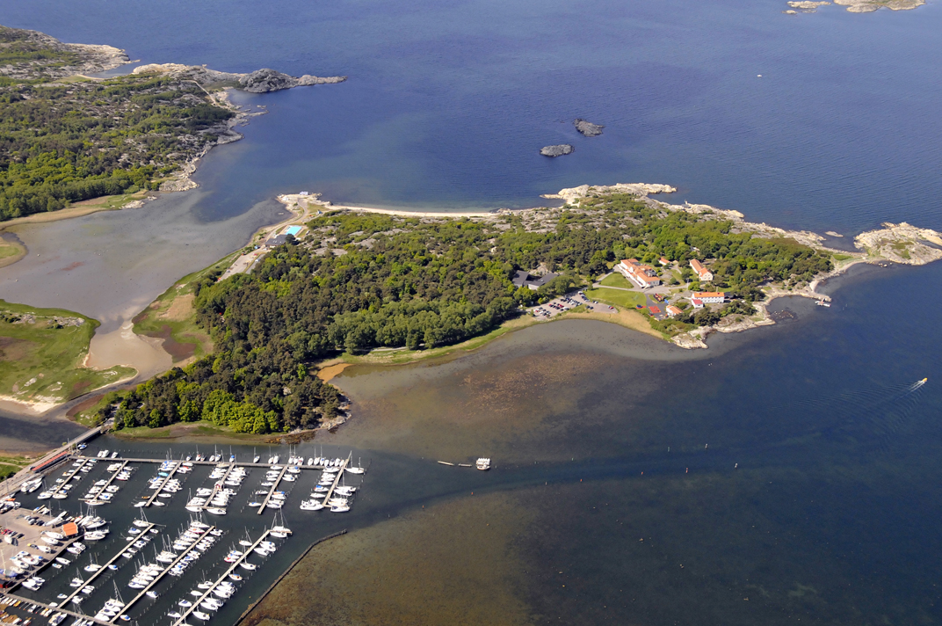
Adaptions for people with intellectual and neuropsychiatric disabilities
A physically facilitating environment,
clear, logic, easy to understand and remember
every activity has its own place

Slide 31
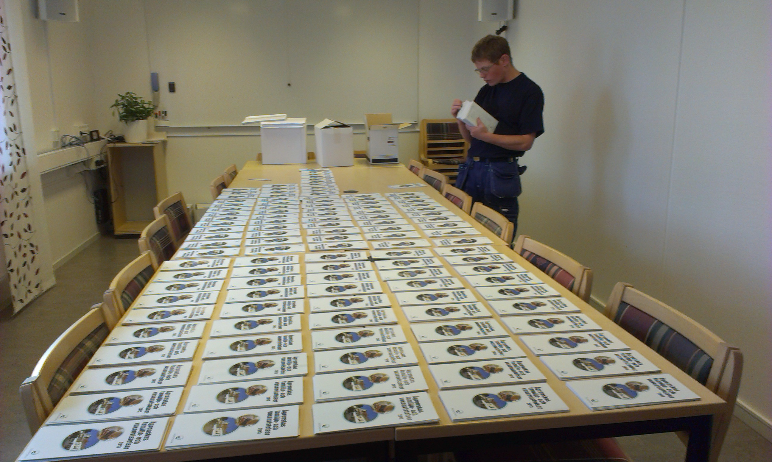
Adaptions for people with intellectual and neuropsychiatric disabilities
Some people like monotonous tasks, others want a lot of change
– like all of us!

Slide 32
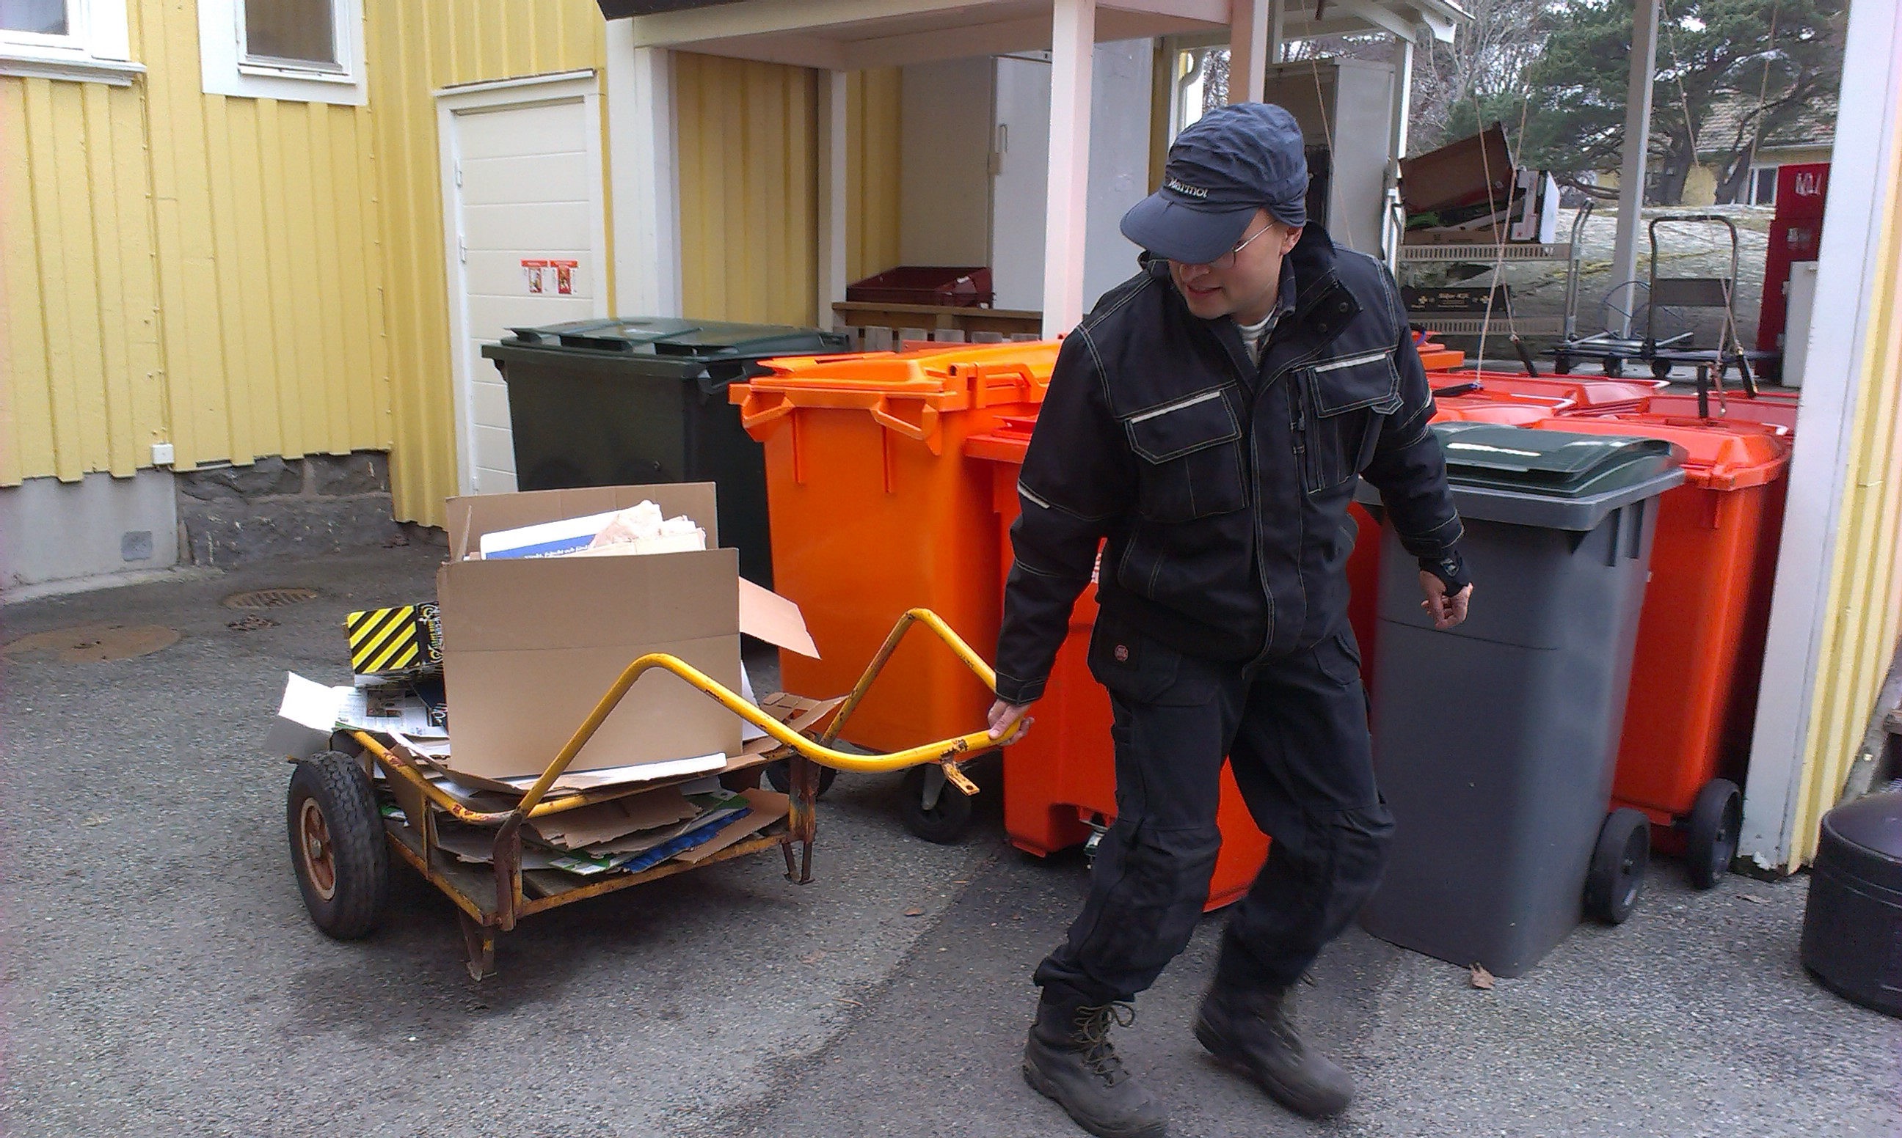
Adaptions - inclusion
Routines make it possible for people with disabilities to perform ordinary, necessary tasks
otherwise performed by someone else

Slide 33
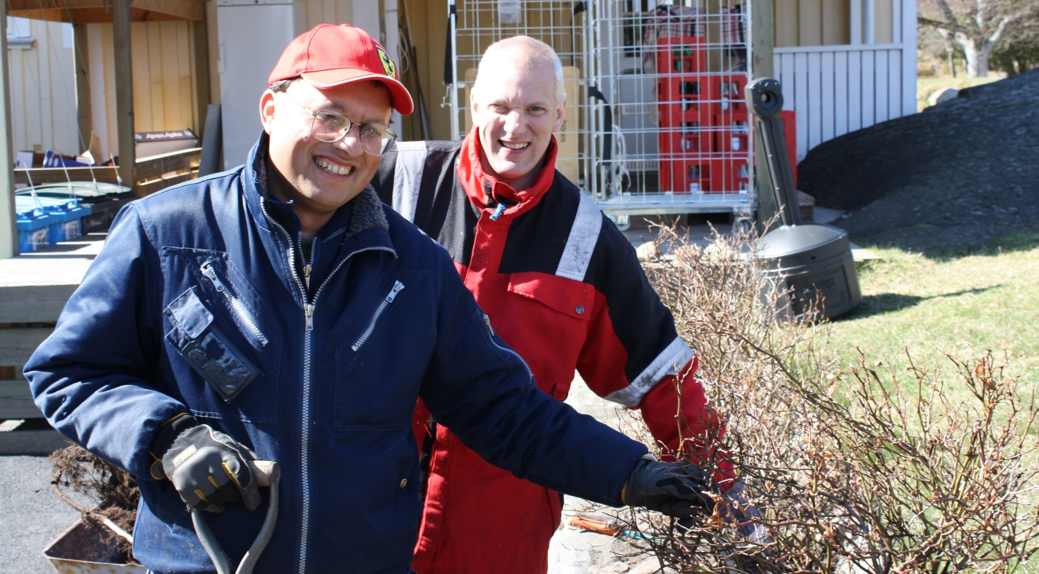
Adaptions - inclusion
Working together facilitates social relations,
essential for a good life

Slide 34
How to facilitate communication - intellectual and neuropsychiatric disabilities?
Use short, simple, clear instructions
One separate instruction at a time
No ambiguous words or expressions
- some people understand literally

Slide 35
How to facilitate communication – neuropsychiatric disabilities?
Esp for neuropsychiatric problems:
Facts – straight to the point
– no social euphemisms
Don´t rely on gestures and mimicry

Slide 36
Other needs - arrangements
Interviews with adults with different diagnoses - needs
realistic choices
long term thinking

Slide 37
Other needs - arrangements
Short stature
working position
frequently used objects within reach
small stool to stand on
avoid lifting heavy things

Slide 38
Other needs - arrangements
Vision problems
extra light
computer magnification program
computer keyboard with big letters
adjustable screen fastening device –
(avoid leaning forward, bad working position, muscle problems)
sunglasses

Slide 39
Other needs - arrangements
Hearing impairments
no group instructions - surrounding noise
no noisy environment, ear plugs
disturbing noise is tiresome – achieves less

Slide 40
Other needs - arrangements
Unilateral problems eg from cerebral
palsy, dysmelia, accidents
Beware of the risk of getting strain injuries
from over-using e.g the working arm

Slide 41
Other needs - arrangements
Fatigue
flexible working hours
sheltered place for rest during daytime
(if tasks allow and if not working full time)

Slide 42
The informed patient /individual
- adapted, accessible and correct information about rare diseases
Background
an abundance of information on the internet of unknown quality
makes it even more difficult for people with cognitive disabilities to get access to purposeful information

Slide 43
The informed patient /individual
- adapted, accessible and correct information about rare diseases
Purpose
enable people with cognitive disabilities make informed decisions concerning their lives

Slide 44
The informed patient /individual
- adapted, accessible and correct information about rare diseases
Being realistic when choosing education/profession –
also some parental responsibility to
help guiding

Slide 45
The informed patient /individual
- adapted, accessible and correct information about rare diseases
Methods
rewrite texts of existing documentation into easily comprehensible texts
in cooperation with representatives
with the diagnoses and
with medical experts

Slide 46
The informed patient /individual
- adapted, accessible and correct information about rare diseases
Neurofibromatosis
22q11 deletion syndrome
Klinefelter,
Noonan,
William syndromes
www.agrenska.se

Slide 47
To achieve inclusion- tips to employers
Investigate the formal aspects and rules - taking social responsibility must be affordable for an employer
Do not idealise, be aware of and accept that it will require some effort and work

Slide 48
To achieve inclusion- tips to employers
The staff needs to accept that people have different possibilities,
people are alike and different,
but we are all human beings with equal value and a right to participation in society and a good life

Slide 49
To achieve inclusion- tips to employers
Equal value does not mean that everybody shall be treated in the same way,
but with respect and according to their possibilities

Slide 50
To achieve inclusion- tips to employers
Consider the possibility to employ more than one person with a disability
Is there a special department with more suitable tasks?
A supervisor/boss/contact person important

Slide 51
To achieve inclusion- tips to employers
Get information, facts about the person, his/her diagnose
Get facts about the disability/diagnose
and its consequences
- in everyday life generally
- in working life especially
and in the specific workplace

Slide 52
To achieve inclusion- tips to employers
How does the person him/herself describe his possibilities and limitations?
Consider together with the individual what kind of adaptations that will be necessary
e. g. in physical environment, equipment and aids, in tasks
Decide together how and what to inform the other staff about

Slide 53
To achieve inclusion- tips to employers
Realistic expectations and demands
- not too high and not to low
Reasonable demands important,
you cannot refer everything to the disability and be excused e.g.
for not being on time

Slide 54
To achieve inclusion- tips to employers
An employer network might be a good idea, to exchange experiences and support each other
Cooperation with schools for teen agers/young adults with disabilities

Slide 55
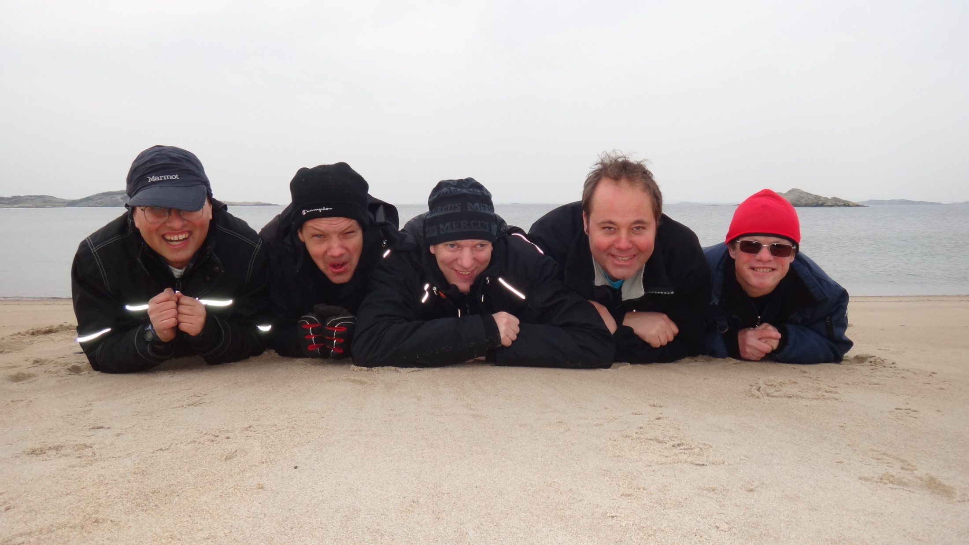

Slide 56
